Slide 1
R Shiny for Operations and GIS
Instructor: Geoffrey Arnold

Slide 2
Course Details

Slide 3
Class Logistics
There is no required text for this course, but supplemental websites and materials will be provided
There will 2 graded projects and 3 homework assignments
The lowest homework grade will be dropped
Each student will be required to submit their own code for assignments but working with a partner or group is encouraged.
Assignments will be due on Friday at Midnight

Slide 4
TA Info

Slide 5
About the Instructor
Education:
University of Pittsburgh: BA Political Science & History 2010
Heinz College: MS PPM 2015
Professional:
PA State Democratic Party: Field Organizer 2010
City Year Greater Philadelphia: Senior Corps Leader: 2011-2012
Lutheran Child & Family Services: Group Leader 2013
City of Pittsburgh: Performance Improvement Analyst 2015-2017

Slide 6
Basic Concepts of Shiny apps
They’re all just functions

Slide 7

Three Basic Parts of the function
UI – User Interface
Builds the webpage
Can be done in R code OR HTML
Server
Generates all reactive content
Can be used to change portions of UI
Session
Used for generating messages to users
Creating bookmark URL’s

Slide 8
Basic Concepts of Shiny apps
Building a User Interface

Slide 9
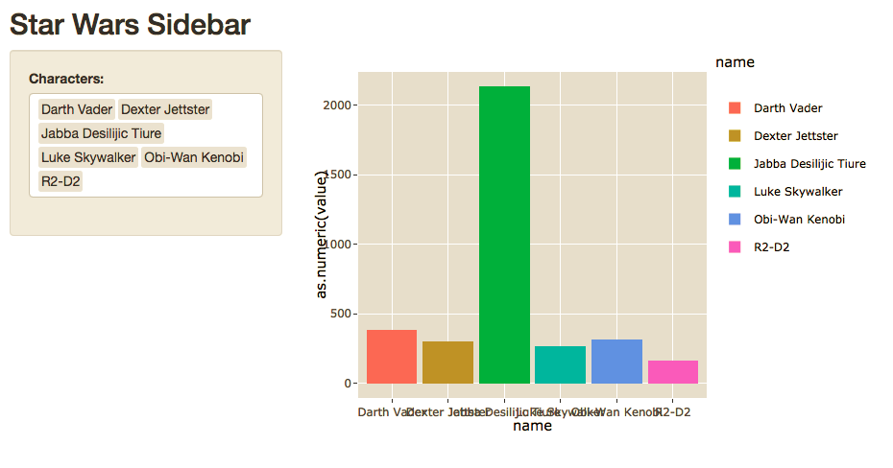
Sidebar Layout

Slide 10
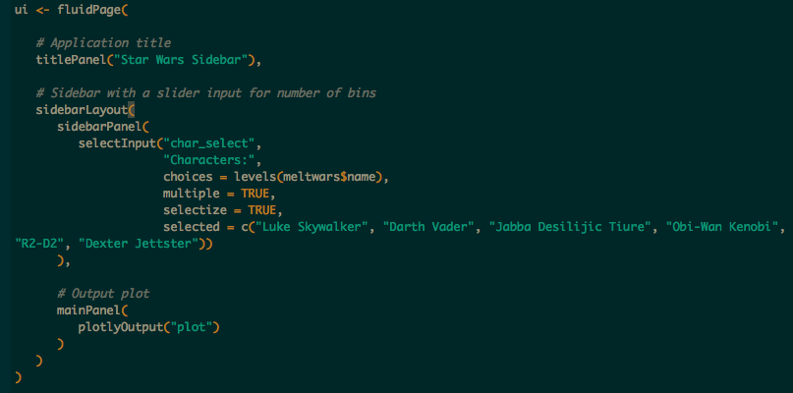

Slide 11
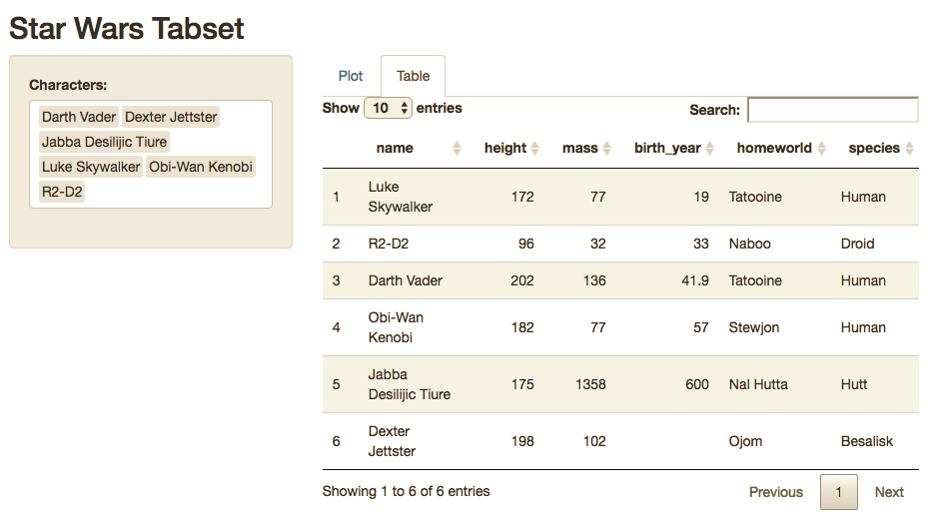
Sidebar w/ Tabset

Slide 12
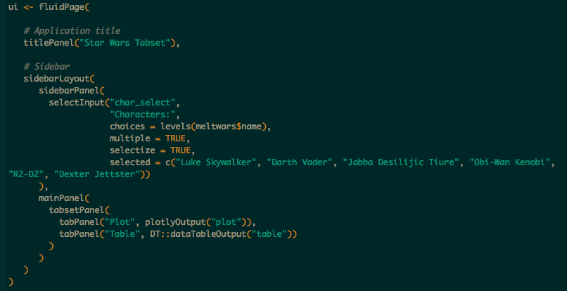

Slide 13
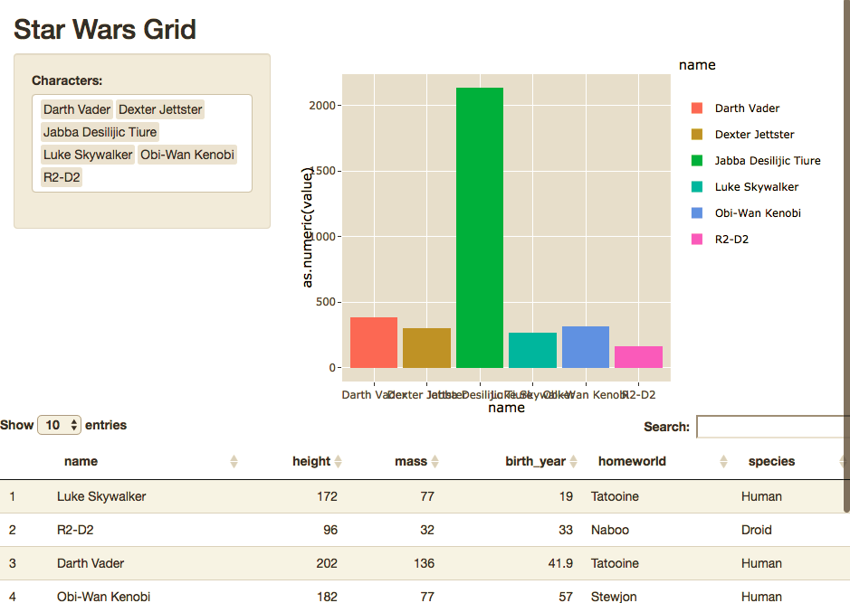
Grid

Slide 14
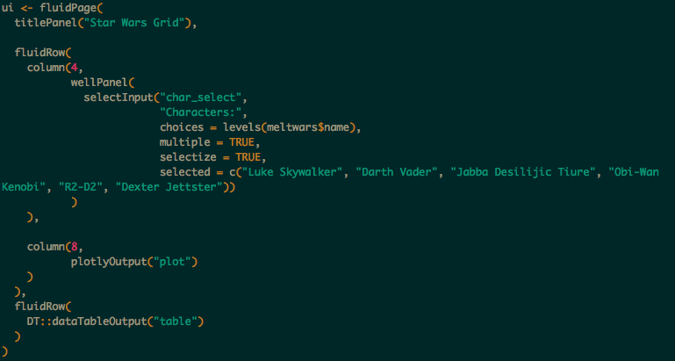

Slide 15
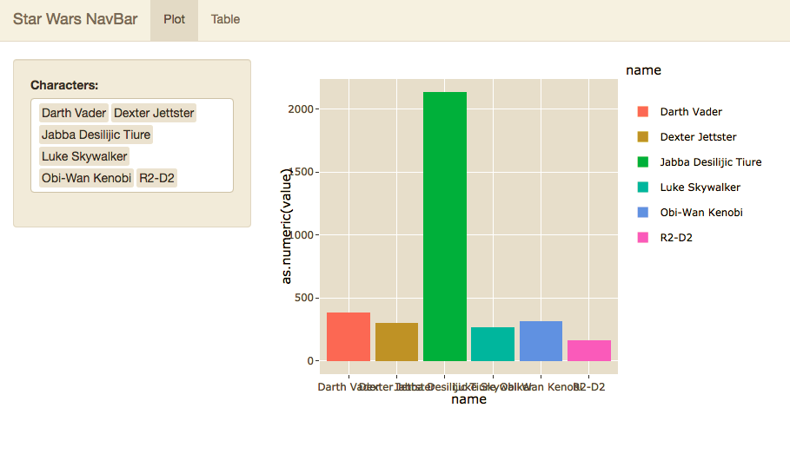
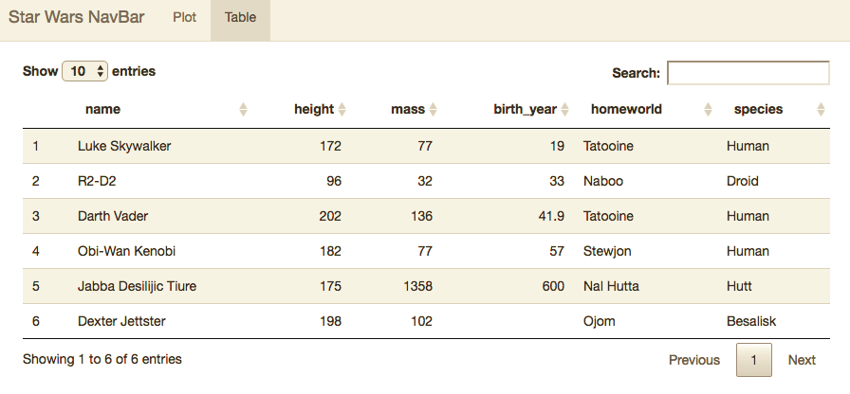
NavBar

Slide 16
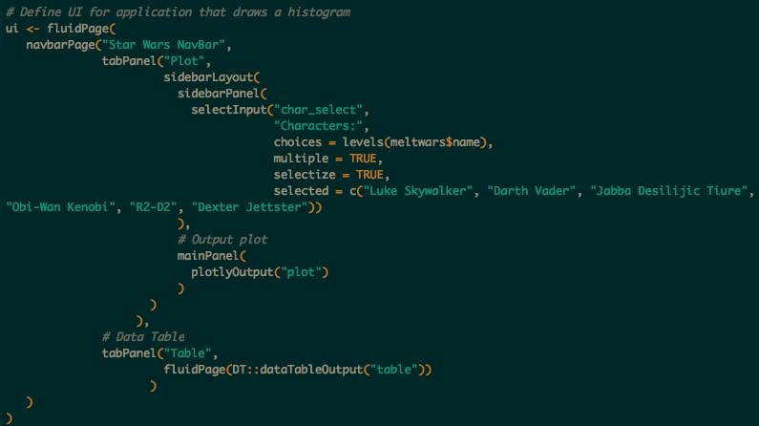

Slide 17
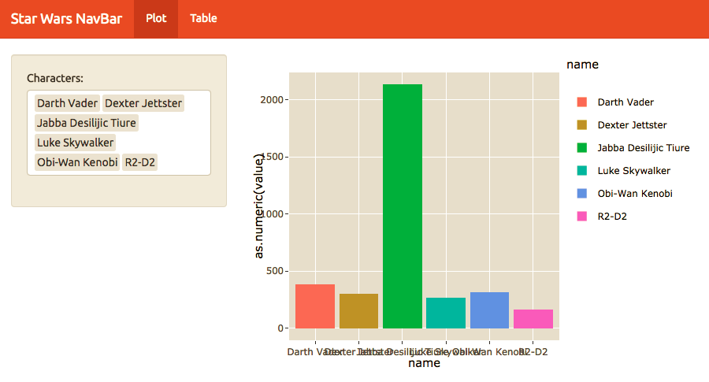

Custom Theme

Slide 18
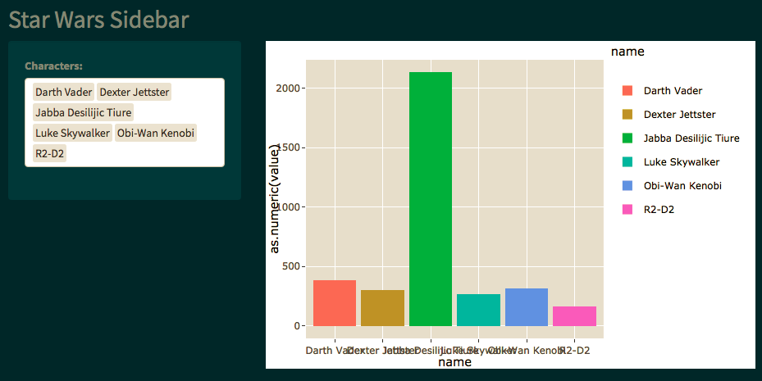

Custom Themes

Slide 19
Basic Concepts of Shiny apps
Intro to Server

Slide 20
Introduction to Server Function
Outputs
List of functions called in the UI which generates plots, tables and other objects.
Will regenerate whenever dependent inputs are changed, or based off of required action in UI.
Shiny Apps will display from any graphics package including;
ggplot2
plotly
DT
LeafletR
ggvis
googleVis
wordcloud2
d3heatmap
dygraphs
ggmap
highcharter
rgl
DiagrammeR
rCharts

Slide 21
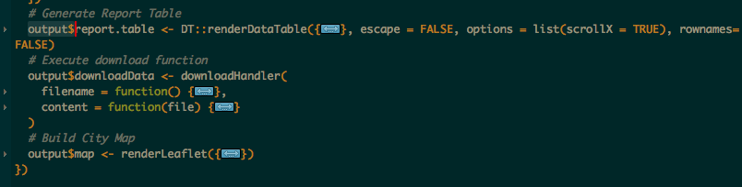
Saving Outputs
Output is a list which you build onto as you create your visuals
Each entry in the list is called in the UI by the name saved.
Example:
The three outputs below are called by “report.table”, “downloadData” and “map” respectively.
Otherwise these images work just like anything created in an RMarkdown document

Slide 22
REVIEW
Shiny Apps are made of up of three arguments.
Ui
Server
Session (if used)
There are numerous layout selections and combinations
To easily style your map you can use custom or free css bootstraps
Outputs are functions which generate the desired content for the app’s UI

